Slide 1

SAP Build Training for Corporate Professionals
DAY-6
www.anubhavtrainings.com

Slide 2


DISCLAIMER
The training content and delivery of this presentation is confidential, and cannot be recorded, or copied and distributed to any third party, without the written consent of Anubhav Trainings

Slide 3
Agenda
APIHUB
What is API and API HUB
Trigger Process
Test the process by using an API trigger
Scenario 2
Sales order approval process
Decision table
Determine agent

Slide 4



Form URL
BTP Admin
(default)
Anubhav
SAP Build Process Developer
Sumit
IDP Admin
Welcome1
Mr. Subbu
Raj Shetty
Ananya
Create instances and subscription
Working BTP cockpit
CIS service
Destination
Assign role to Admin
Create Build Subscription
User management
Role Management
Create Workzone
Import standard apps
Role for Build workzone
Assign the role to the business user
Default Site
Create Build Projects
Create process
Test Process
Deploy Process
Give form URL gives to Ananya
My Inbox

Slide 5
What is Environment in Build Process Automation
An environment is a functional area in which you deploy and run your SAP Build Process Automation projects.
You use an environment to control how you deploy and execute projects. A project can be deployed in more than one environment and for different project versions. By creating shared environments, you can increase the security of deployed projects and the corresponding artifacts and resources, by limiting access and managing project members.
You can use two types of environments:
Shared: A shared environment is created by users with the ProcessAutomationAdmin role and can be shared to users with the ProcessAutomationDeveloper role. By creating more than one shared environment on your SAP Build Process Automation tenant, you can isolate the deployment of different projects or project versions.
Public: The public environment contains all of the existing projects already deployed in SAP Build Process Automation. The settings in the environment correspond to the settings already made for these projects. Access to the public environment is protected at the tenant level so every user who has access to the tenant has access to the public environment.
Each environment contains distinct configurations that define the conditions for the running projects. These include: Projects, Automation Launchers, Triggers, Agent Management, Alert Handlers, Variables, API Keys, Visibility Scenarios, Processes and Workflows

Slide 6
Data types
Data types are the skeleton of the data. They will comply usually with APIs of S/4HANA. So that when we trigger our build process automation e.g. from S/4HANA, the data can be passed easily.
What is a work item
When we execute a step, at runtime the user/approver will receive a notification, that is due to the runtime instance of a step which was executed in process. The runtime instance of a step of the process is called work item. This will be received typically in a standard app in BTP work zone called My Inbox app.
Context
A context is the data which is circulated and available in our business process throughout the execution of the process. This data will be based on the data type we create and connect to api trigger. Usually this is available in JSON (Java Script Object Notation).

Slide 7
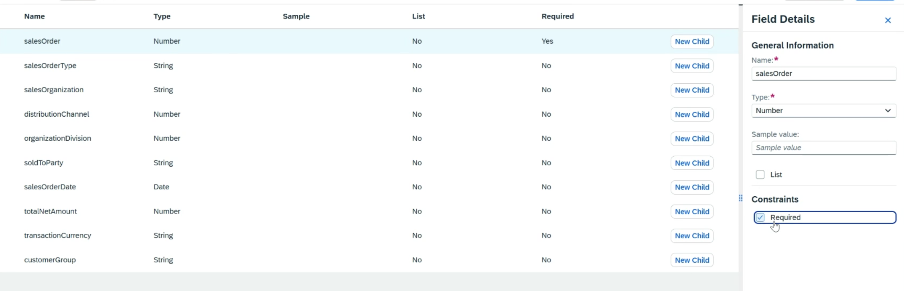
Create data type for Sales order
{
"salesOrder": "1212",
"salesOrderType": "IN",
"salesOrganization": "1010",
"distributionChannel": 10,
"organizationDivision": 10,
"soldToParty": "ANUBHAV",
"salesOrderDate": "2025-12-02",
"totalNetAmount": 480,
"transactionCurrency": "EUR",
"customerGroup": "GRP1“
}

Slide 8
JSON
{
key: ‘value’,
key: ‘value’,
key: ‘value’
}
orderNo shipTo date
101 | SHIP1 | 20251212

Slide 9


Scenario
Build Process Automation
BTP
Sales Order
approval
<data>
form
mail
Manager
<data>
Sales Representative
(fedEx office)
Build workzone
My Inbox
S/4HANA

Slide 10
What is API?
API stands for application programming interface, it is a contract between our system and a system which is trying to connect with us.
API gives a contract between caller and called party
That makes integration possible w/o knowing internal functionality of system
Critical role in integration and exchange of data between systems
Servers as single entry point for different business objects (so,po,material)

Slide 11
API HUB
SAP provides a publicly available website. Any developer can go and explore the APIs offered by SAP Solutions e.g. S/4HANA, BTP, Success Factors, Field Glass, Concur etc.
https://api.sap.com
You can request S/4HANA server access – server@anubhavtrainings.com

Slide 12



















Slide 13

The Postman tool
Postman is a popular API (Application Programming Interface) testing and development tool. It provides an easy-to-use interface for interacting with APIs, enabling developers, testers, and other users to test, debug, and document APIs efficiently. It is widely used in the software development lifecycle to ensure that APIs function as intended.
Send requests (GET, POST, PUT, DELETE, etc.) to APIs and receive responses.
Validate the API’s behavior, response codes, and data.
Simplifies sending HTTP requests without needing to write complex scripts.
Supports various authentication methods like OAuth, Basic Auth, Bearer Token, etc.
Reduces manual effort by automating repetitive tasks.
Helps in documenting APIs for better team understanding.
Integrates well into agile and DevOps workflows.
It is available as a desktop application, web application, and browser extension, making it accessible across different platforms.
https://www.postman.com/downloads/

Slide 14
Requirement
If the sales order amount < 500 EUR – There is no approval required, a direct email will be sent to process initiator that order was auto approved.
Decision Table
When we need to determine multiple conditions, then we can opt for decision table. A control will create branch(s) in the business process but a decision table is a step itself. The control will be used to trigger multiple steps and manage the flow of process at runtime but the decision table is predominantly used to determine the context data at runtime.
e.g. If the sales order type is OR – Standard Order – approval should go to Anubhav – Anubhav.abap@gmail.com
If the order type is IN – inquiry – approval should go to Vaishali – Vaishali@evotrainingsolutions.com
Example of dynamic agent determination like we do in classic abap workflow.

Slide 15
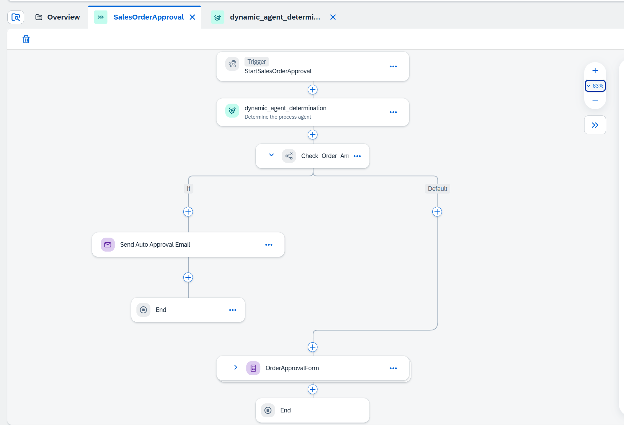

Slide 16

What We Did
Let’s Summarize
www.anubhavtrainings.com

Slide 17
www.anubhavtrainings.com
Thank You
End of Day 6
www.anubhavtrainings.com

Slide 18



We’re committed to empower you to be
#FutureReady
through powerful training solutions.
We build the workforce of the future.
250+
Corporate Clients
30,000+
Learners Trained
25000+
Learners Placed
FREE WEBINARS
Sign up for free webinars with industry experts every fortnight!
Enroll Now!
Contact us today!
https://anubhavtrainings.com

